Slide 1

Portfolio Project Progress Presentation
Adam Hurst

Slide 2
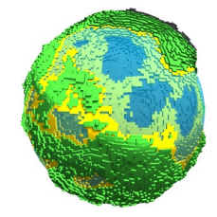
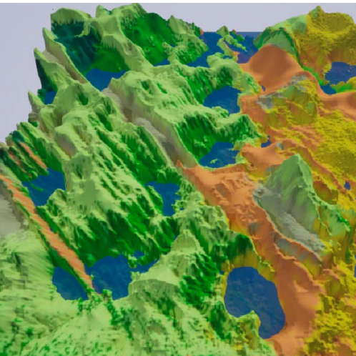
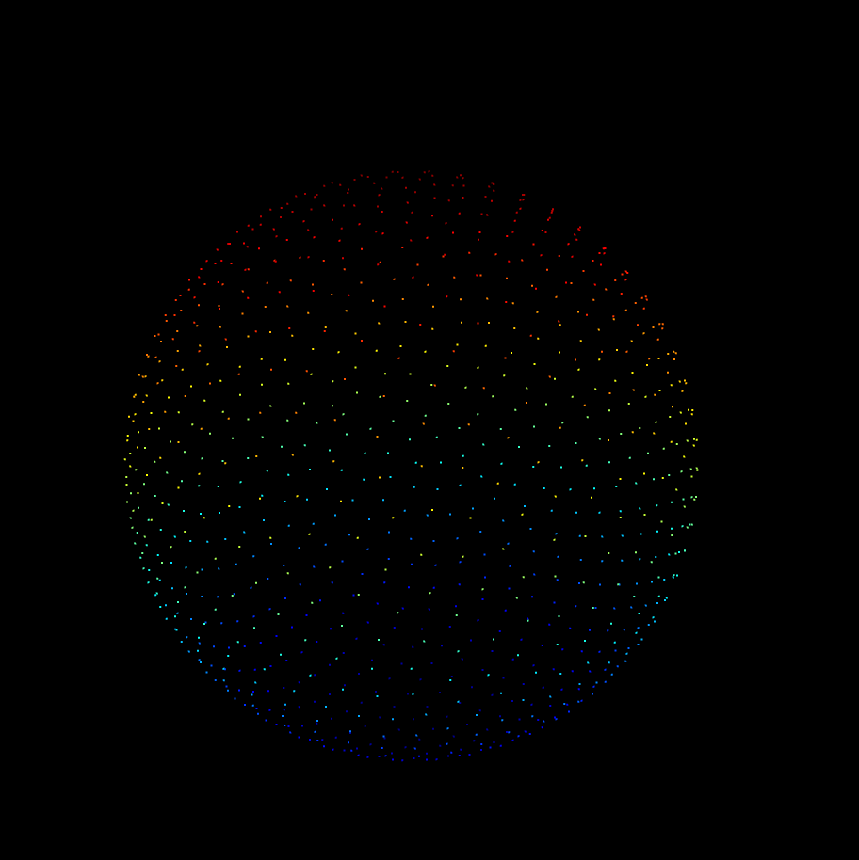
Topics
Context
Research
Progress
Plan to Completion

Slide 3

Context

Slide 4
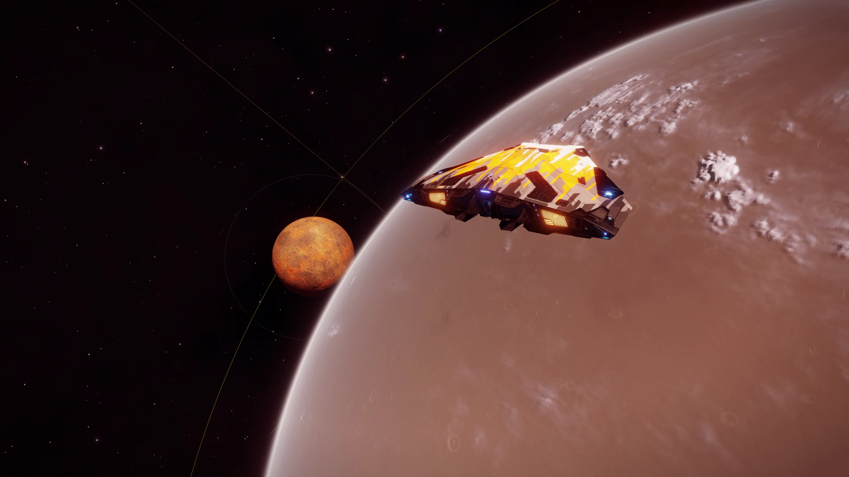
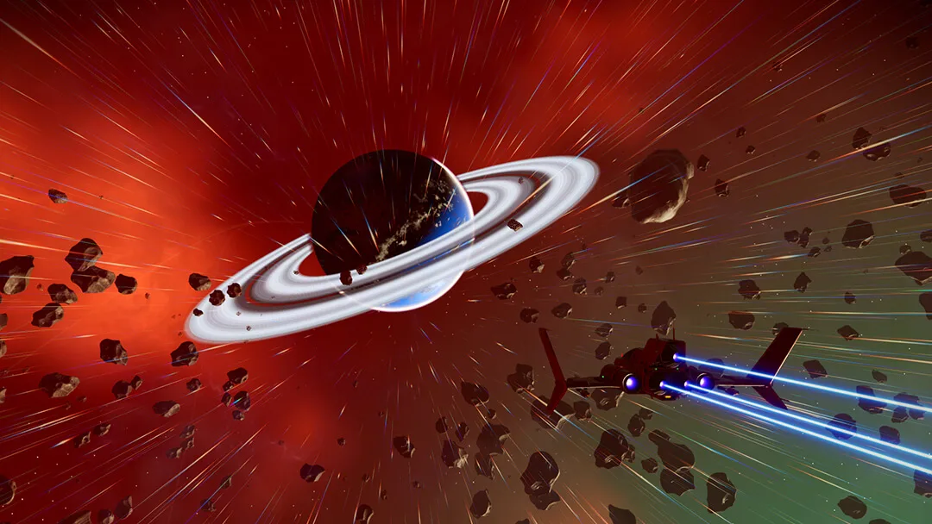
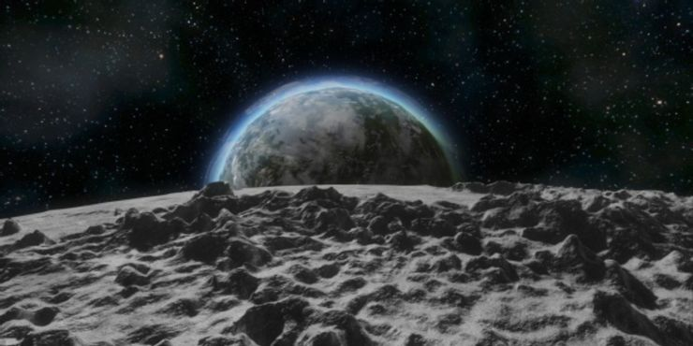

Slide 5
Elite Dangerous
No Man’s Sky
Space Engineers
Elite Dangerous
Scale 1:1
Realistic but boring
No Man’s Sky
Incredibly diverse, interesting planets
Small, not realistically scaled planets
Space Engineers
Seamless blending between space and planets
Small, low detail planets

Slide 6
Goals of Project
Create realistically sized planets
Diverse
Seamless gameplay experience
Outputs
Unity Game
Unity Package

Slide 7
Research

Slide 8
Sphere Generation
Terrain Generation
Level of Detail
Atmospheric Rendering
Floating Point Precision
Main areas of Research

Slide 9
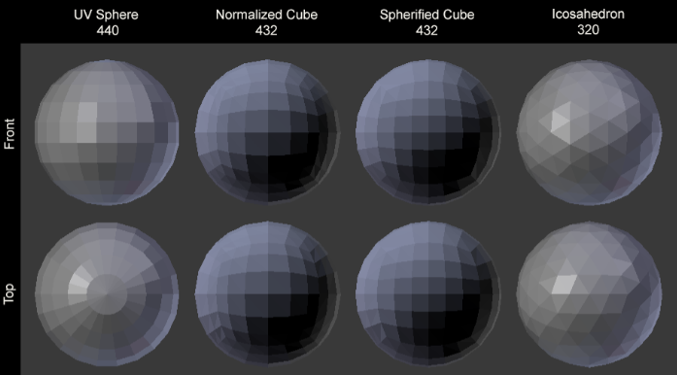
Sphere Generation

Slide 10
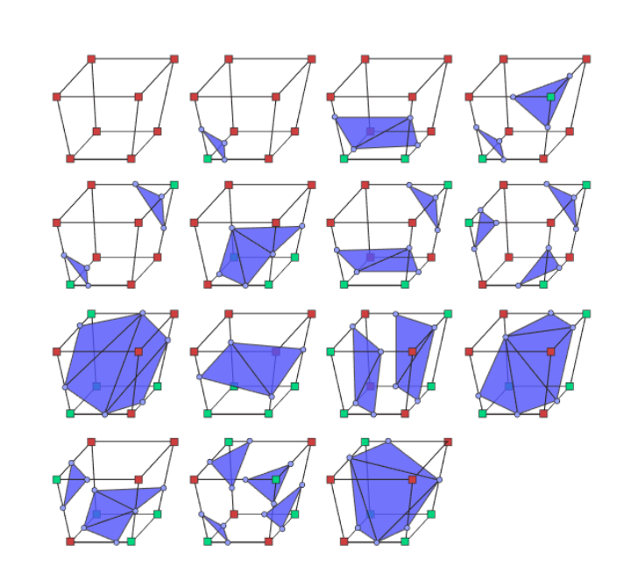
Sphere Generation

Slide 11
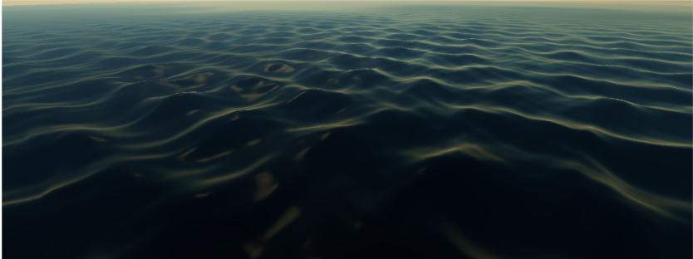
Terrain Generation

Slide 12
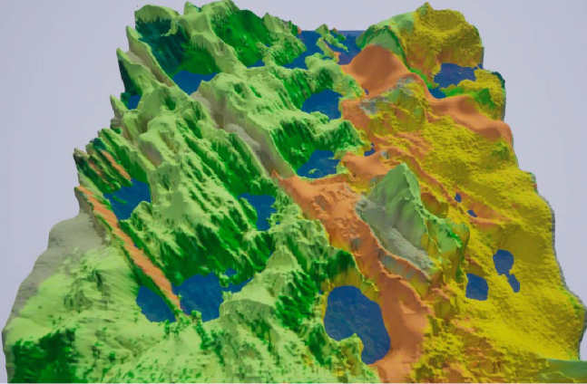
Terrain Generation

Slide 13
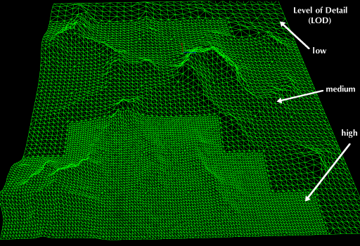
Level of Detail

Slide 14
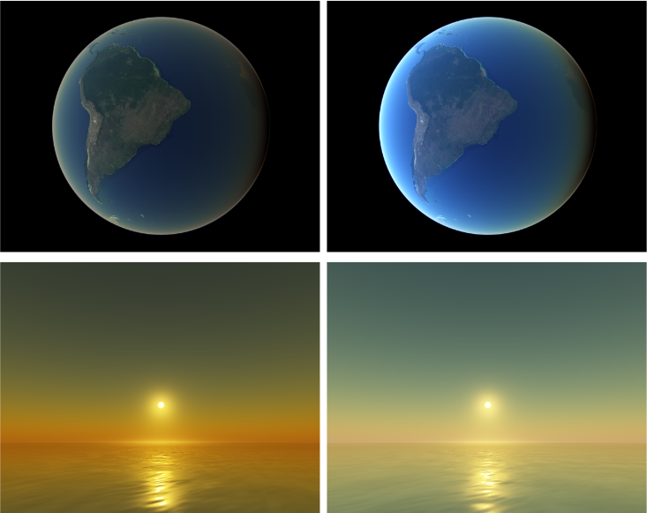
Atmospheric Rendering

Slide 15
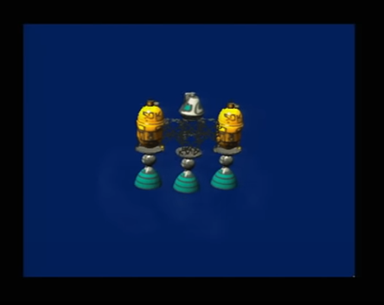
Floating Point Precision

Slide 16
Progress

Slide 17
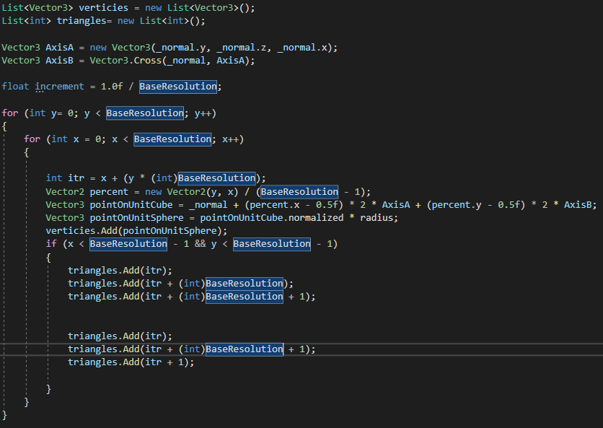

Slide 18
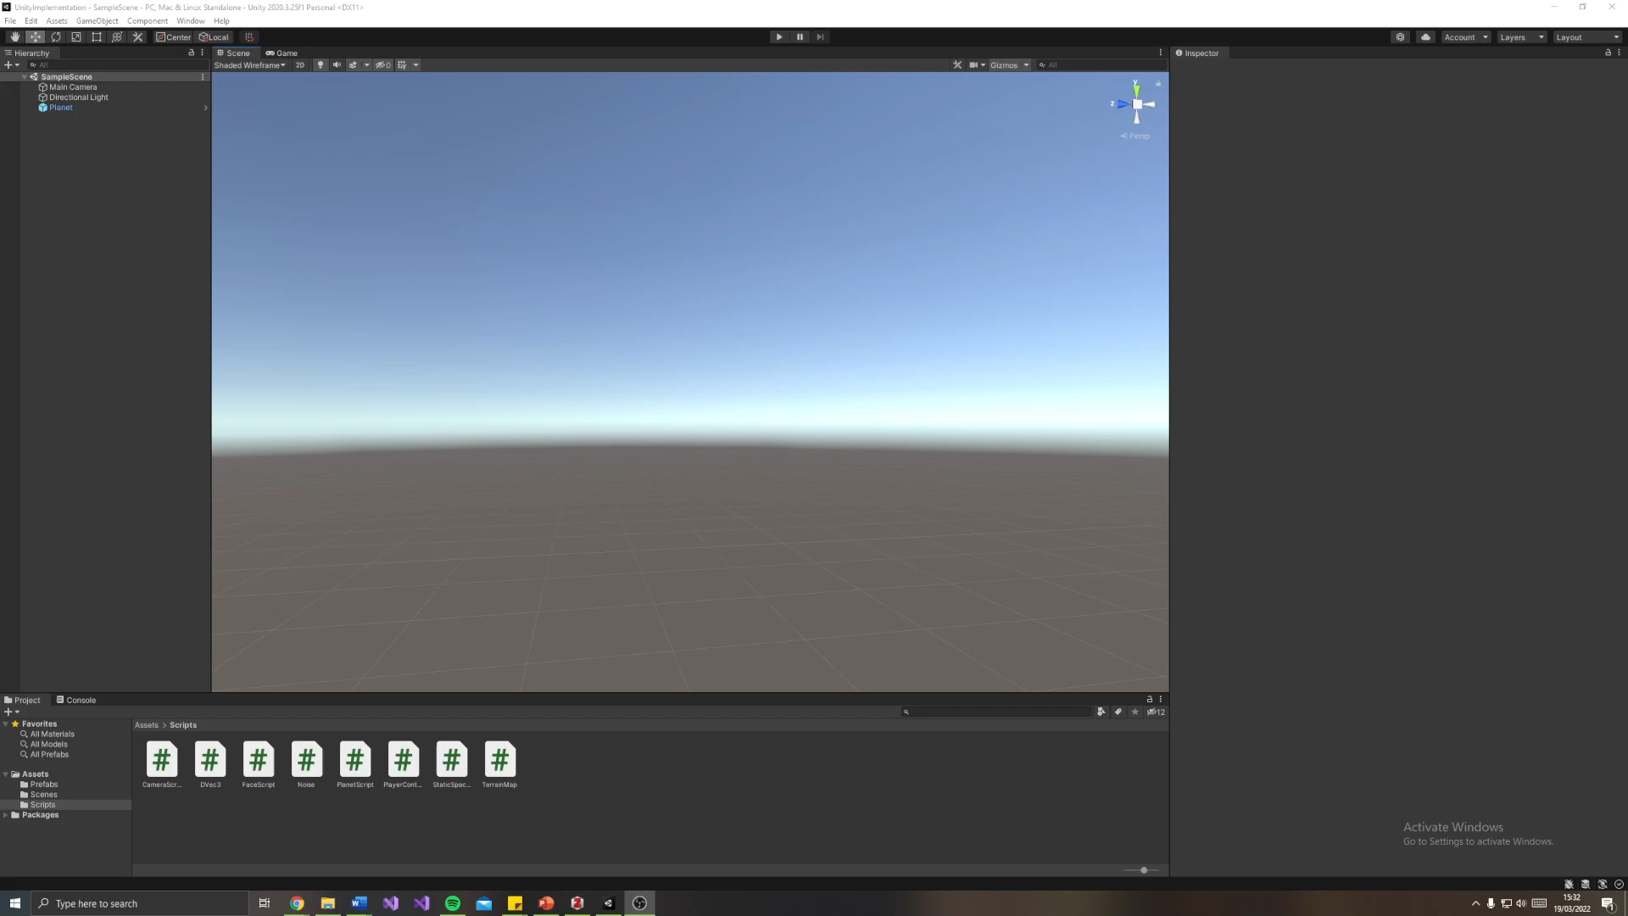

Slide 19
Plan to Continue

Slide 20
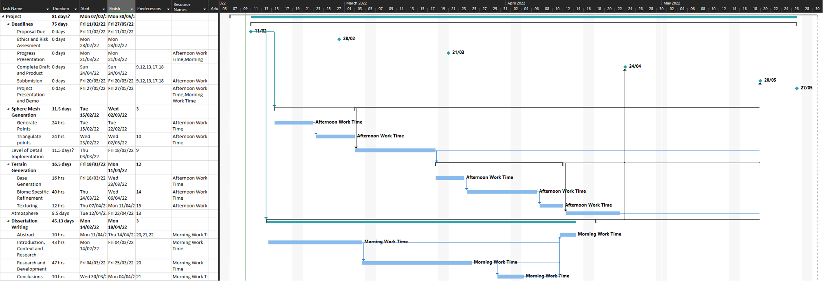
Plan

Slide 21
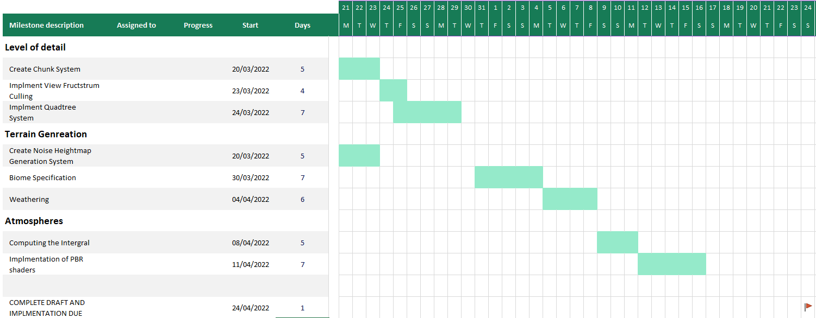

Slide 22
References
Ackroyd, L., 2021. Space Engineers: Everything You Need To Know About Planets [online]. TheGamer. Available from: https://www.thegamer.com/space-engineers-everything-need-know-planets/ [Accessed 20 Mar 2022].
Anon., 2022a. no-mans-sky-next1.jpg (1080×608) [online]. Available from: https://bgr.com/wp-content/uploads/2018/07/no-mans-sky-next1.jpg?quality=82&strip=all [Accessed 20 Mar 2022].
Anon., 2022b. jMonkeyEngine Docs [online]. Available from: https://wiki.jmonkeyengine.org/docs/3.4/core/terrain/terrain.html [Accessed 20 Mar 2022].
Building Worlds in No Man’s Sky Using Math(s), 2017. Available from: https://www.youtube.com/watch?v=C9RyEiEzMiU [Accessed 19 Mar 2022].
Cajaraville, O. S., 2019. Four Ways to Create a Mesh for a Sphere. Medium [online]. Available from: https://medium.com/@oscarsc/four-ways-to-create-a-mesh-for-a-sphere-d7956b825db4 [Accessed 2 Feb 2022].
Christio02, 2021. Will we be able to land on planets like this in Odyssey? r/EliteDangerous [online]. Available from: www.reddit.com/r/EliteDangerous/comments/mkl48g/will_we_be_able_to_land_on_planets_like_this_in/ [Accessed 20 Mar 2022].
Elek, O., 2009. Rendering Parametrizable Planetary Atmospheres with Multiple Scattering in Real-Time, 8.
Fischer, R., Dittmann, P., Weller, R. and Zachmann, G., 2020. AutoBiomes: procedural generation of multi-biome landscapes. The Visual Computer, 36 (10–12), 2263–2272.
Keinert, B., Innmann, M., Sänger, M. and Stamminger, M., 2015. Spherical fibonacci mapping. ACM Transactions on Graphics, 34 (6), 1–7.
O’Neil, 2022. A Real-Time Procedural Universe, Part Three: Matters of Scale [online]. Available from: https://www.gamasutra.com/view/feature/131393/a_realtime_procedural_universe_.php [Accessed 4 Feb 2022].
Patel, A., 2022. Delaunay+Voronoi on a sphere [online]. Available from: https://www.redblobgames.com/x/1842-delaunay-voronoi-sphere/ [Accessed 4 Feb 2022].
Schafhitzel, T., Falk, M. and Ertl, T., 2007. Real-Time Rendering of Planets with Atmospheres, 8.
Sin, Z. P. T. and Ng, P. H. F., 2018. Planetary Marching Cubes: A Marching Cubes Algorithm for Spherical Space. In: Proceedings of the 2018 the 2nd International Conference on Video and Image Processing [online]. Presented at the ICVIP 2018: 2018 the 2nd International Conference on Video and Image Processing, Hong Kong Hong Kong: ACM, 89–94. Available from: https://dl.acm.org/doi/10.1145/3301506.3301522 [Accessed 21 Feb 2022].
Unite 2013 - Building a new universe in Kerbal Space Program, 2013. Available from: https://www.youtube.com/watch?v=mXTxQko-JH0 [Accessed 10 Feb 2022].

